Slide 1
Wind Speed Dataset with Observation-Based Bias Correction and Multi-Model Fusion at 23 U.S. Locations
Wenqi Zhang, Julie Bessac, Mitchell Krock, Ignas Satkauskas
DOE Open Energy Data Initiative (ODEI) | 2026

Slide 2
Overview
What is this dataset?
  Two related hourly wind speed datasets at 23 U.S. locations
  Period:
  2018-2020 (single-model correction)
  2015-2020 (multi-model correction + fusion)
  Designed for energy applications and wind-related research.
Why it matters
  Physic-based models have systematic biases as opposed to observations, especially in the tails
  Full-distribution bias correction is needed beyond just mean adjustment
  Multi-model fusion combines complementary model strengths
Observation-Based Bias-Corrected Sup3rCC
  Source: Sup3rCC physic-based downscaled model
  Period: 2018-2020 | Hourly | 23 U.S. locations
  Method: BATs marginals + Gumbel mixture copula
Multi-Model Fusion (ERA5 + MERRA2)
  Sources: ERA5 (ECMWF) and MERRA-2 (NASA GMAO)
  Period: 2015-2020 | Hourly | 23 U.S. locations
  Method: Copula bias correction + Bayesian Model Averaging (BMA)

Slide 3
Background and Motivation
Physics-Based Model Limitations
  Biases from spatial resolution, parameterization uncertainty, and numerical schemes
  Wind speed distribution from models underestimates extremes and often misrepresent seasonal patterns
Why Bias Correction Matters
  Grid planning, coastal management, and agriculture require accurate extremes
  Correction must span the full distribution with bulk AND both tails
Why Parametric Distribution for Bias Correction
  Bulk-and-Tails (BATs) distribution capture both central behavior and tail extremes in a single parametric model. Parametric distributions enable reliable correction in sparse-data tail regimes; most commonly-used methods (e.g. quantile mapping) are data-driven and therefore limited to available data, potentially scarce in the tails.
Why Multi-Model Fusion?
  ERA5 and MERRA-2 differ substantially in wind speed by site and season
  No single dataset is uniformly superior across all 23 locations
  Simple averaging ignores differences in local model skill
Bayesian Model Averaging (BMA)
  Assigns performance-based weights to each bias-corrected source
  Produces a probabilistic integrated final product
  Quantifies uncertainty and improves accuracy vs. any single model

Slide 4
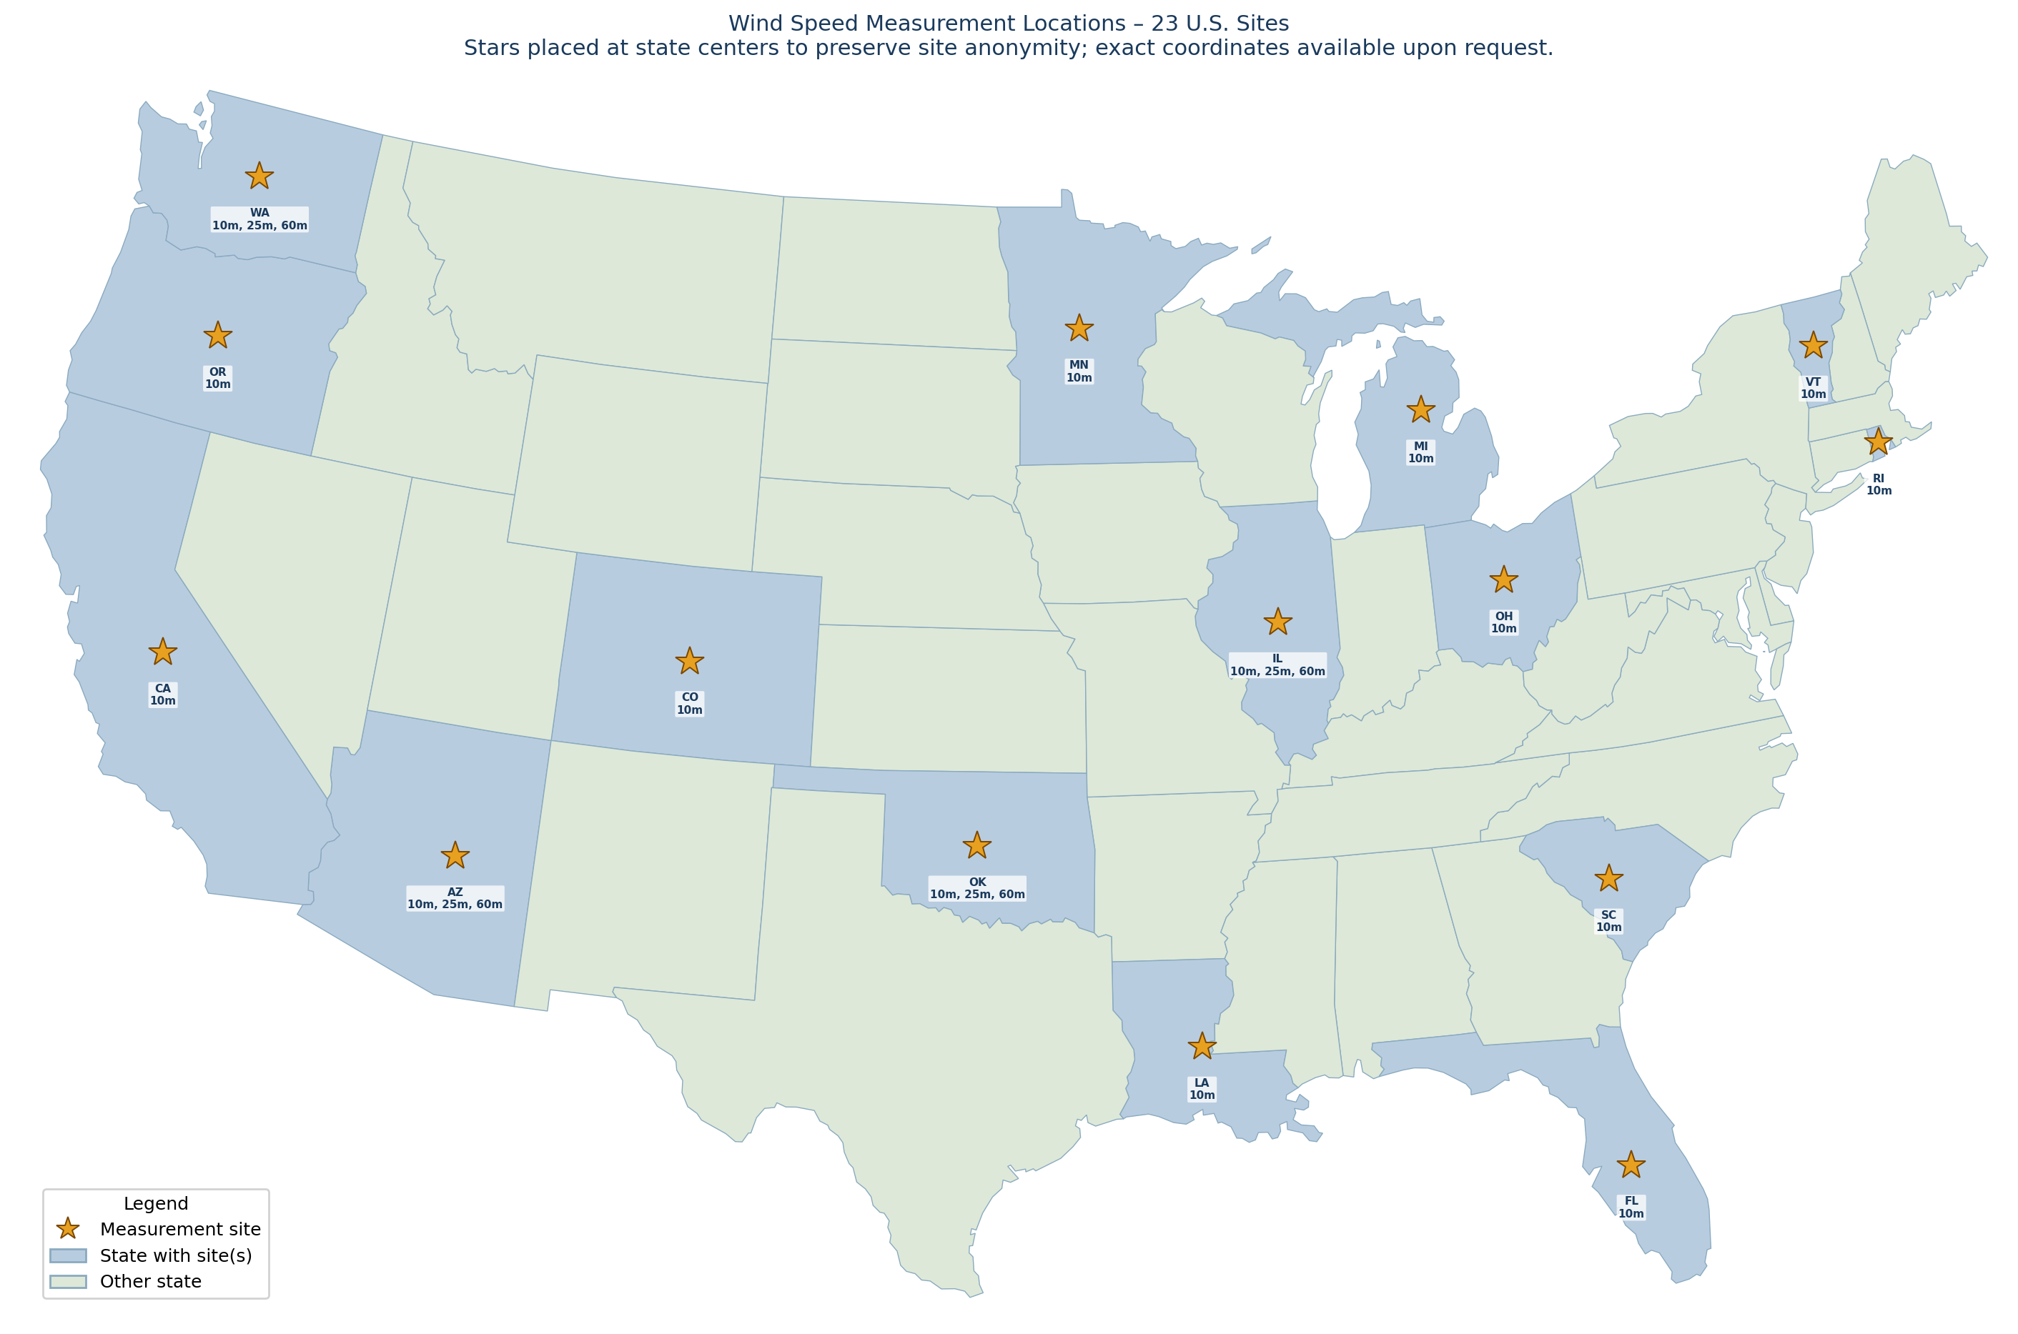
Data Coverage: 23 U.S. Locations
Geographic Diversity
  23 sites spanning diverse U.S. regions: coastal, inland, mountainous, and plains
  Sites selected to test generalizability across varying topography and meteorology
Measurement Data
  Hourly in situ wind speed at variable hub heights
  Used for training, bias correction, and evaluation
Site Anonymity
  Stars are placed at state centers to preserve site anonymity
  Exact site coordinates and heights are available upon request

Slide 5
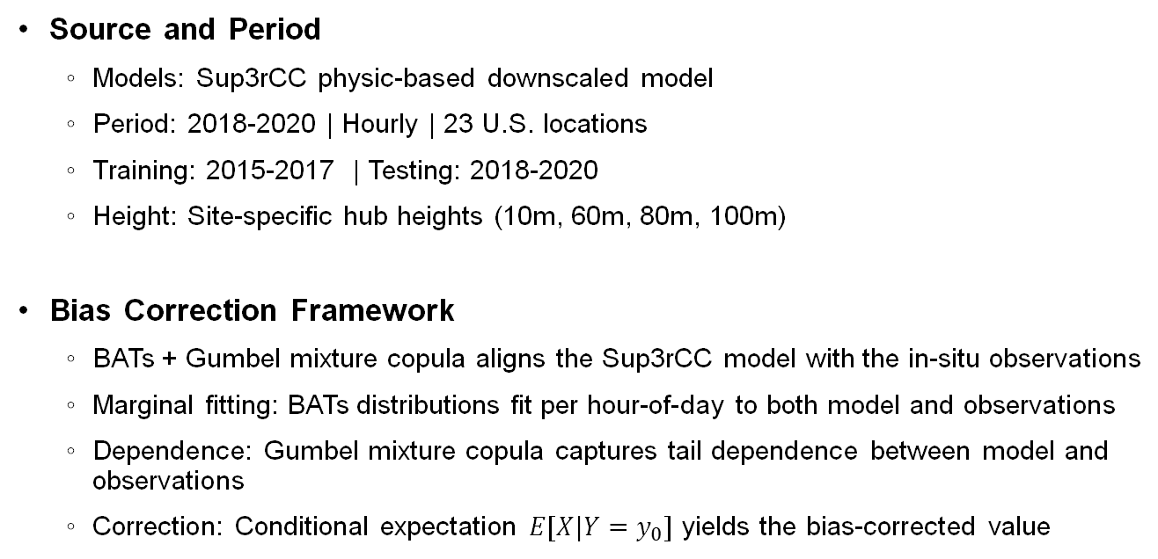
Dataset 1: Observation-based Bias-Corrected Sup3rCC
Source and Period
  Models: Sup3rCC physic-based downscaled model
  Period: 2018-2020 | Hourly | 23 U.S. locations
  Training: 2015-2017 | Testing: 2018-2020
  Height: Site-specific hub heights (10m, 60m, 80m, 100m)
Bias Correction Framework
  BATs + Gumbel mixture copula aligns the Sup3rCC model with the in-situ observations
  Marginal fitting: BATs distributions fit per hour-of-day to both model and observations
  Dependence: Gumbel mixture copula captures tail dependence between model and observations
  Correction: Conditional expectation $E[X|Y=y_{0}]$ yields the bias-corrected value

Slide 6
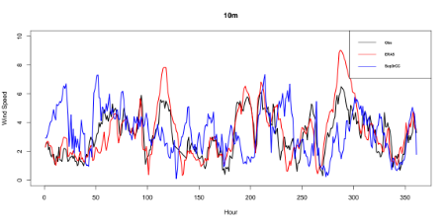
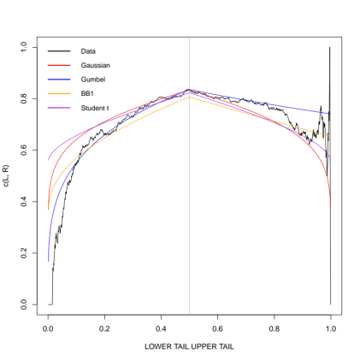
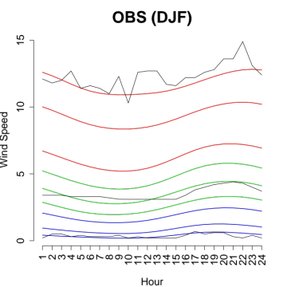
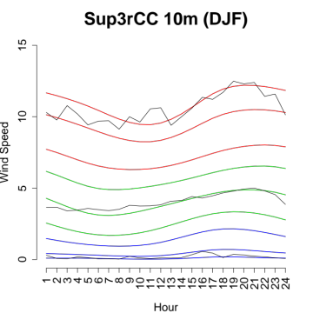
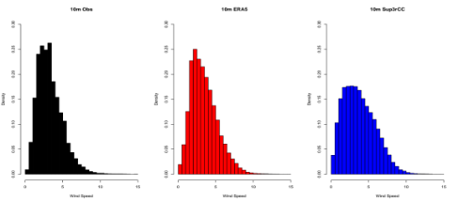
Dataset 1 Bias Correction Steps
Marginal model
Joint copula
-> model interaction between observations and model data
Observations
Model outputs
Marginal model
Different statistics from different sources of data
Discrepancies between data and models
Fitting of flexible marginals from our prior works (Krock et al., 2021) on bulk-and-tails modeling
-> good fitting of wind quantiles including in the tails
Fitting of copula between model data and observations
-> good fitting of the dependence between two sources of data
Winter - Measurements
Winter – NREL Sup3rCC
Wind speed
Time (hour)
Quantile dependence
Wind speed quantile
Observation
Model ERA
Model sup3rCC
Hour of the day
Hour of the day
Lower tail
Upper tail

Slide 7
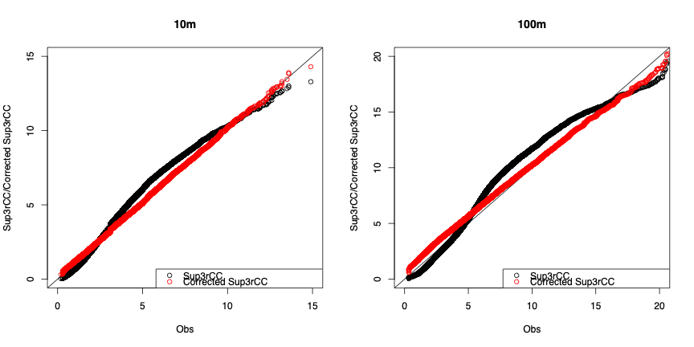
Validation – Quantile-Quantile plots
State & Context
  Site: Argonne National Laboratory (ANL), IL
  Heights: 10m (left) and 100m (right) hub heights
  Period: 2018-2020 | Black = raw Sup3rCC |
  Red = Corrected Sup3rCC
  Diagonal = perfect 1:1 agreement with observations
Expected Outcome (Zhang et al. 2025)
  Raw Sup3rCC (black) systematically underestimates observations, especially in the upper tail
  Corrected Sup3rCC (red) aligns closely with the 1:1 diagonal across both bulk and tail
  Improvement is more pronounced at 100m where raw model bias is larger

Slide 8
Dataset 2: Multi-Model Fusion (ERA5 + MERRA-2)
Source and Period
  Models: ERA5 and MERRA-2
  Period: 2015-2020 | Hourly | 23 U.S. locations
  Training: 2010-2014 | Testing: 2015-2020
  Height: Site-specific hub heights (10m, 60m, 80m, 100m)
Two-Step Framework
  Stage 1 – Copula Bias Correction (ERA5 and MERRA-2 corrected independently:
    BATs + Gumbel mixture copula aligns each model with the in-situ observations – see Slides 5-6
  Stage 2 – Bayesian Model Averaging:
    ECME algorithm estimates performance-based weights per site
    Fused density

Slide 9
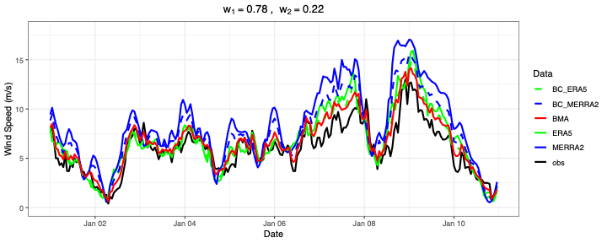
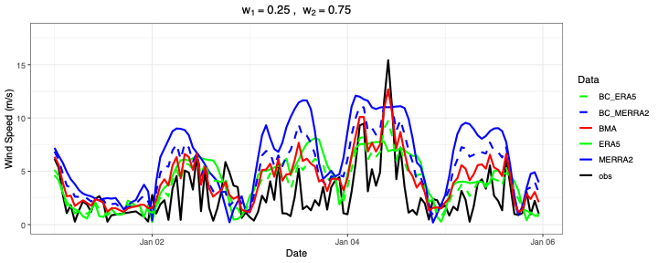
Validation – Time-Series Visualization
State & Context
  Top plot: Argonne National Laboratory (ANL60), IL – 60m hub height
  Bottom plot: National Wind Technology Center (NWTC80), CO – 80m hub height
  Period: 10-day window in January 2010
Expected Outcome (Zhang et al. 2026)
  BMA weights reflect single model skill – ERA5 dominant at Argonne (w1=0.78), MERRA2 dominant at NWTC (w2= 0.75)
  BMA (red) closely tracks observations (black), especially during peak wind events
  Raw ERA5/MERRA-2 tend to overestimate; bias-corrected versions (dashed) better align with observation
  BMA integrates complementary strengths by site, yielding lower RMSE than any individual source

Slide 10
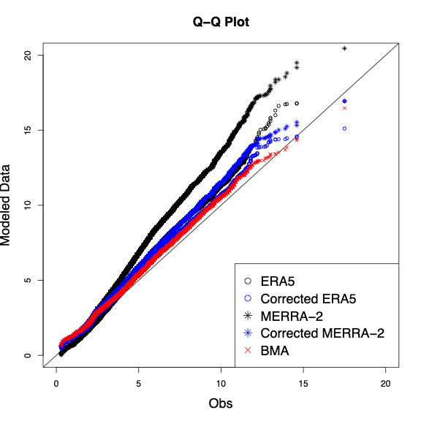
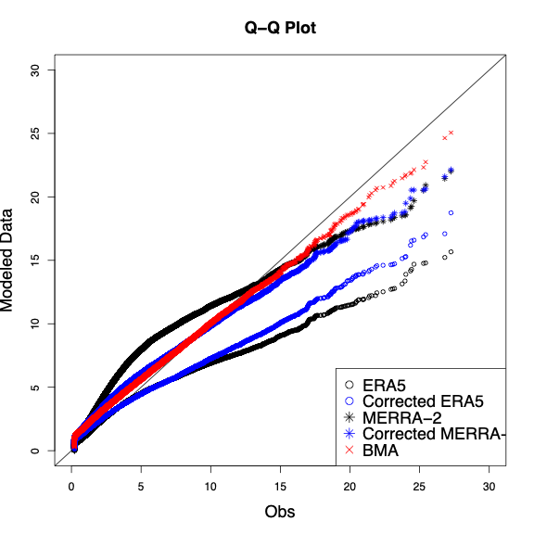
Validation – Quantile-Quantile Plots
State & Context
  Left plot: Argonne National Laboratory (ANL60), IL – 60m hub height
  Right plot: National Wind Technology Center (NWTC80), CO – 80m hub height
  Period: 2015-2020
  Black = ERA5 | Blue = MERRA-2 | Red = BMA
  Diagonal = perfect 1:1 agreement with observations
Expected Outcome (Zhang et al. 2026)
  Raw ERA5 and MERRA-2 overestimate at ANL60 and underestimate at NWTC80, especially in the upper tail
  Bias-corrected versions align more closely with the 1:1 diagonal
  BMA (red) provides the best overall agreement across both bulk and tail at both sites
  Improvement is more pronounced where raw model bias is larger

Slide 11
Data Access, Citation, and Future Work
Data Access
  Repository: OEDI
  Github URL: https://github.com/fzhang-WZ/Copula_BC.git
Citations
BATs: Krock M. et al. (2021). Nonstationary seasonal model for daily mean temperature distribution bridging bulk and tails. Weather and Climate Extremes, 36, June 2022, 100438
Sup3rCC: G. Buster, et al. (2023). Super-resolution for renewable energy resource data with climate change impacts (Sup3rCC). DOE Open Energy Data Initiative (OEDI); National Laboratory of the Rockies.
  ERA5: Hersbach, H. et al. (2020). The ERA5 global reanalysis. Quarterly Journal of the Royal Meteorological Society, 146(730), pp.1999-2049.
MERRA2: Gelaro et al. (2017). The modern-era retrospective analysis for research and applications, version 2 (MERRA-2). Journal of climate, 30(14):5419–5454.309
  Dataset 1: Zhang W. et al. (2025). A Copula-Based Bivariate Bias Correction Method for Super-Resolved Physics-Based Wind Speed Data. IEEE PESGM. https://ieeexplore.ieee.org/abstract/document/11225336
  Dataset 2: Zhang W. et al. (2026). A Probabilistic Framework for Bias Correction and Fusion of Multi-Model Datasets. Data Science in Science, 5:1. DOI: 10.1080/26941899.2026.2675582
Contact
  Wenqi Zhang – flora.zhang@nlr.gov
  Julie Bessac | Ignas Satkauskas | National Laboratory of the Rockies
  Mitchell Krock | University of Missouri
Future Work
  Extend to additional physics-based models (WRF, CESM, GCM outputs)
  Explicit spatiotemporal dependence modeling across multiple sites
  Application to other energy-related variables, e.g., precipitation, temperature, humidity,…
  Integration into operational workflows
Acknowledgement
  Supported by the U.S. DOE Grid Modernization Lab Consortium and DOE Office of Science Early Career Research Program, Contract DE-AC36-08GO28308.

